Slide 1
Software Factory – Enterprise TFS
Software Factory NTI
Mike O’Brien, Toby Hable
September 2014

Slide 2
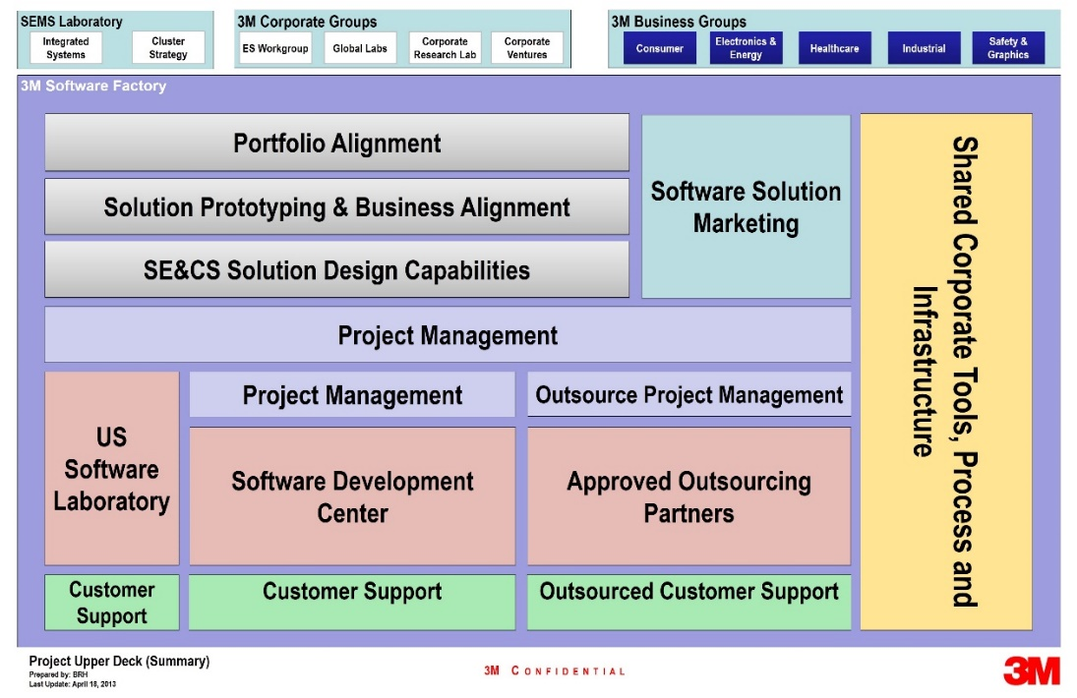












3M Software Factory – Software Engineering for the Future
Building the software engineering capabilities needed to enable rapid, high-quality and profitable product development.
Specialized Software Skillsets
Software Process Development
State of the Art Software Infrastructure
Divisions + ES Workgroup
Goal
Provide an Enterprise ALM Service for all 3M Software teams.

Slide 3
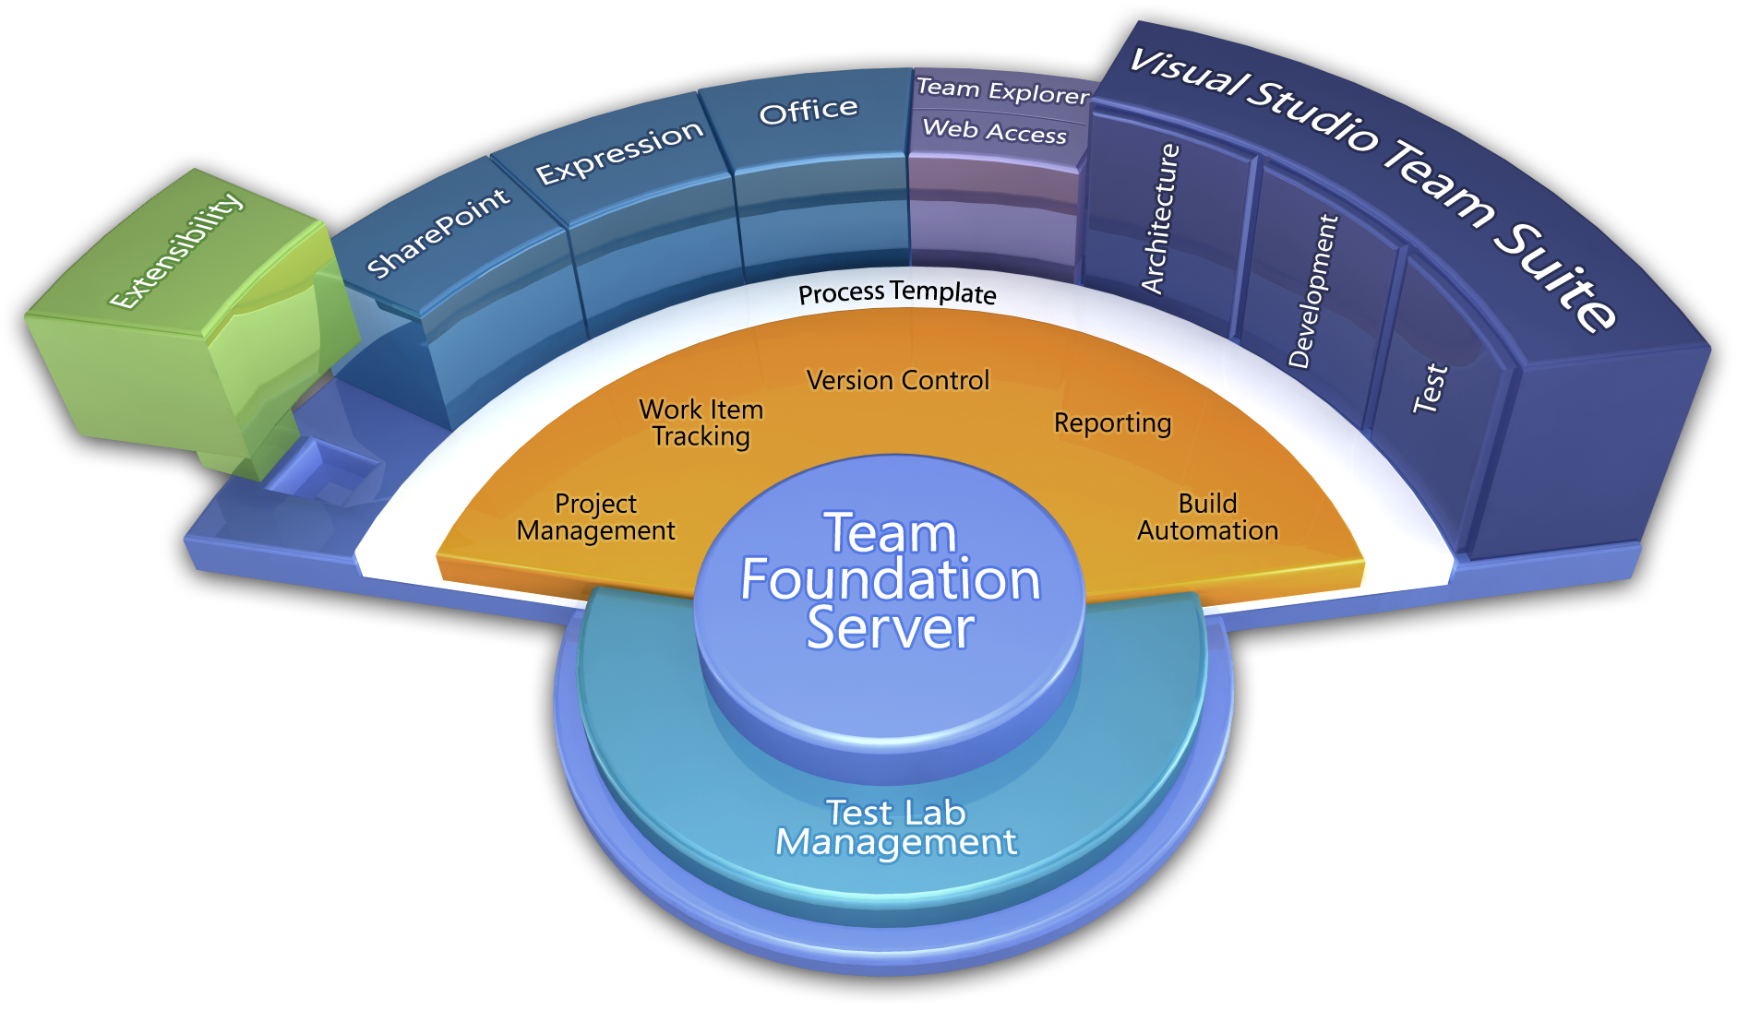
What is Team Foundation Server (TFS)?
Team Foundation Server is a Microsoft product which provides source code management, reporting, requirements management, project management, automated builds, lab management, testing and release management capabilities.
Process / Optimization
Project Management
Requirements Management
Design & Architecture
Release Management
Development
QA & Test
Application Lifecycle Management (ALM)
Application Lifecycle Management using Visual Studio Team Foundation Server provides proven practices to manage application lifecycle. Manage source code across teams; develop, build, and test applications; plan projects, track work, and report progress.

Slide 4
Current ALM Landscape at 3M
Current Situation
TFS in wide use across 3M – up to 30 servers
Each with staff to maintain, backup and upgrade
Annual cost per server = $42k
30 servers = $1.2M
And more systems coming online every day!
Decentralized Services within 3M
Small scale development systems
Lack of common infrastructure
Little or no reuse of solutions across groups/divisions/company
Redundancy of personnel
Underutilization of technology
TFS
Rational
Notes:
Divisions with resources needed to support infrastructure
As Divisions move to ETFS, resources are freed up to develop

Slide 5
Value of Centralized ALM Solution
Decentralized
Accelerate development process maturity company wide
Measure process metrics - focus on quality and efficiency
Standardize development process and tools
Reduces licensing costs by eliminating redundant tools
Power in numbers - Negotiation of future costs
Training, software licenses, hardware, Microsoft is taking notice of corp level activities…
Groups mature individually
Centralized
Process Improvement Value (CMMI)
Reduction in Time to Market: 19%
Productivity Gain: 35%
Early Detection Gain: 22%
Reduction of Post-Release Defects: 39%
Groups mature collectively

Slide 6
ETFS Roadmap
 | Build |  | Adopt | Mature
Timeline | 2014 |  | 2015 | 2016
 | Q2-Q3 | Q4
Cost | Pre-NTI: $45k | Explore: $380k | $350k Budget Gap ($750k Total Operating Budget) | $350k Budget Gap ($900k Total Operating Budget)
Targeted Users | HISD, SEMS (900 users) |  | HIS, SEMS Q3: TSSD, IPD, FSD, SOSD (500+ users) | All
Resources | 2 FTE / 2 Contractors (+1 contractor hire) |  | 2.5 FTE / 2.5 Contractors (+1 contractor hire) | 3 FTE / 3 Contractors (+1 new hire)
Milestones | Service Implementation (Sept – Dec) Engage Microsoft Team: $180k Install QA & PROD Environments Train IT Operations Team Form SEMS DevOps Team Onboard HIS and SEMS teams Develop Demo and training material Perform Demos and training Launch service with HIS and SEMS |  | Work toward Enterprise Software Development Process Complete onboarding HIS and SEMS users (Jan-June) Begin onboarding for additional users (July – Dec) Add to DevOps team (+1 new hire) Establish System Governance for Build, Reports, and Process Expand functionality | Transition ETFS to IT (Managed Services Team) Goal: 80% of software product teams on ETFS Add to DevOps team (+1 new hire) Continue work on Enterprise Software Development Process Drive ALM best practices throughout company by demonstrating functionality of Process, Tools and integrated systems

Slide 7
Budget Breakdown

Slide 8
Demand and Supply

Slide 9
ETFS – User Cost Models
 | Onboarding Cost | Service Cost | Advantages for Users | Disadvantages for Users
1 | Free | Free | Encourages adoption No barrier to entry | -
2 | Free | $10/user per month | Encourages adoption | Financial barrier for usage that does not currently exist Have to develop and manage chargeback system
3 | SEMS Time & Material Charge | Free | Encourages adoption | Financial barrier to adoption
4 | SEMS Time & Material Charge | $10/user per month | - | Financial barrier for usage that does not currently exist Financial barrier to adoption Have to develop and manage chargeback system
Financial barriers to ETFS will hinder adoption and a company wide ALM process.

Slide 10
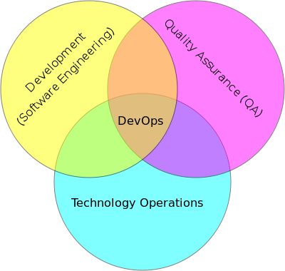
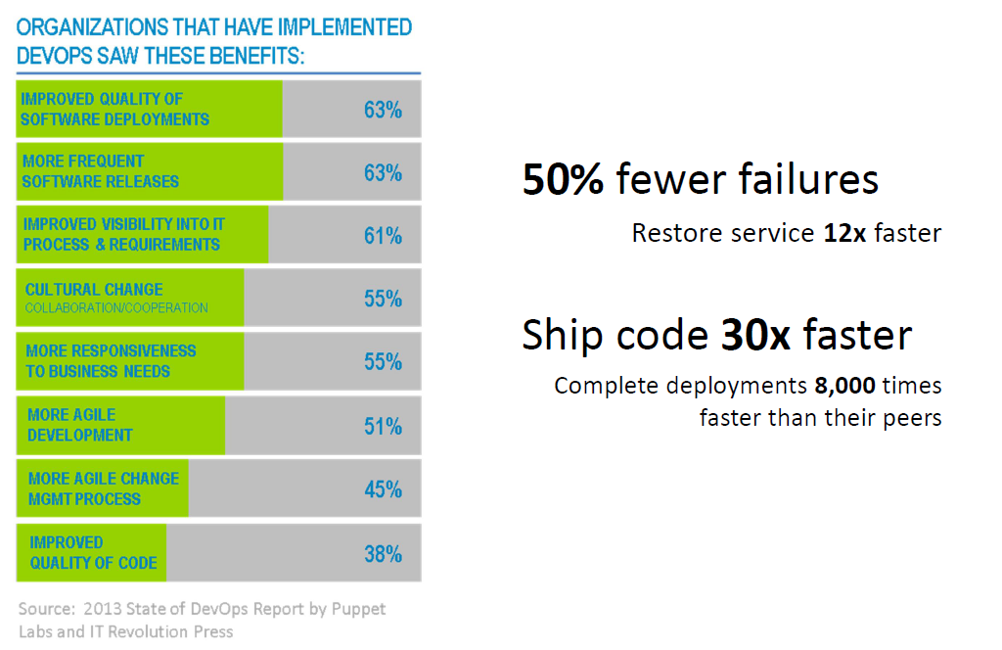
SEMS DevOps
DevOps Role
Automate Build, Deployment, Configuration, Testing and production deployment
SEMS DevOps Role
ETFS - Team Onboarding and Migration
ETFS - Service Enhancements
Perform DevOps Role for SEMS and Division Teams (T&M)
Notes:
“Automate Everything”

Slide 11
ETFS Team Roadmap
Build - 2014 Q4
1 Service Manager
2 DevOps (+1 new contractor)
1 Ops (IT)
Resource Budget: $200k (Sept – Dec)
Service Manager
- Initial contact of new teams
- Provide training
- Maintain relationship with teams
- Oversight of DevOps and Ops Teams
Operations (Ops)
- IT Operations Team
SEMS DevOps
- Team onboarding tasks
- Service enhancements
- Test updates/upgrades, update documentation
- Perform DevOps role for SEMS/Division teams
- ETFS System Maintenance
- Respond to support requests
- Focused on Production System
Adopt - 2015
1 Service Manager
3 DevOps (+1 new contractor)
1 Ops (IT)
Resource Budget: $750k
Mature - 2016
1 Service Manager
4 DevOps (+1 new hire)
1 Ops (IT)
Resource Budget: $900k

Slide 12
Thank You!

Slide 13
Current Costs
Sf
Software
Factory
Current software and hardware | Cost per year
IBM Rational | $232,000
GIT and SNV (freeware) | $0
.75 FTE’s to maintain | $112,500
532 TFS Licenses ($300 over 5 years) | $31,500
Hardware (over 5 years) – estimated | $30,000
Total | $406,000
Cost per users per month | $48 per month
Notes:
TFS current cost is hard to get. Some licenses are in MSDN and some are purchased outright.
Current Cost – ((27000 * 5)/ 5 years))
($27000 *5 team instances)
==========================================
New look for all plans:
5 proxy servers - $6000 each - $30,000

Slide 14
ETFS 2014 Timeline
HIS Target for all TFS teams migrated
Startup Investment
Service Available
All HIS teams migrated
Pre-NTI
May 5
Sept
Jan
March
March
2014
May
Jun
July
Aug
Sep
Oct
Nov
Dec
Jan
Feb
Mar
Apr
May
Jun
Define
Implementation
Ongoing
Today

Slide 15
ETFS Roadmap – Milestones
Build | Adopt | Mature
Service Implementation (Sept – Dec)
Create SEMS DevOps Team: $200k
New Hire - DevOps resource
Startup cost – engage Microsoft Consulting for implementation and verification of service: $180k
IT Operations Team – support of service 24 x 7 x 365 – Train Team
Begin migration of HIS and SEMS Teams
Develop Demo and Training Material
Perform Demos and Training
Launch ETFS with HIS and SEMS users

Slide 16
ETFS Roadmap – Milestones
Build | Adopt | Mature
Work toward Enterprise Software Development Process
Complete onboarding HIS and SEMS users (Jan-June)
Begin onboarding for additional users (July – Dec)
Add to DevOps team (+1 new hire)
Establish System Governance for Build, Reports, and Process
Expand functionality
Drive adoption through increased awareness - Demos

Slide 17
ETFS Roadmap – Milestones
Build | Adopt | Mature
Transition ETFS to IT
Goal: 80% of software product teams on ETFS
Add to DevOps team (+1 new hire)
Continue work on Enterprise Software Development Process
Drive ALM best practices throughout company
Deliver Training and Demos – demonstrate functionality of existing tools and systems

Slide 18
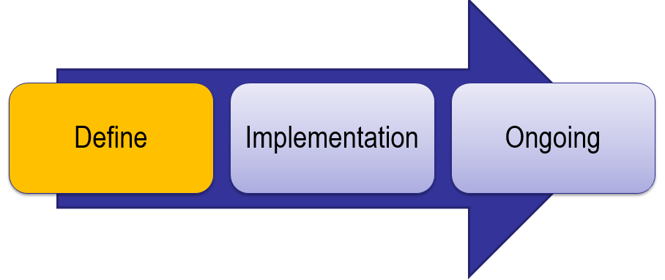
ETFS Timeline
Define Service (Done!)
System Requirements
Definition of the Service
Draft of ‘Cost of Service’
Engaged additional candidate Divisions
System Architecture
Draft of Service Level Agreement (SLA)
CTOC Presentation
Investments Made
Dedicated resource working since 5/5
Weekly update meetings with HIS
Leveraging existing IT Team for Operations
IT can manage TFS licenses
Leveraging existing 3M IT infrastructure

Slide 19
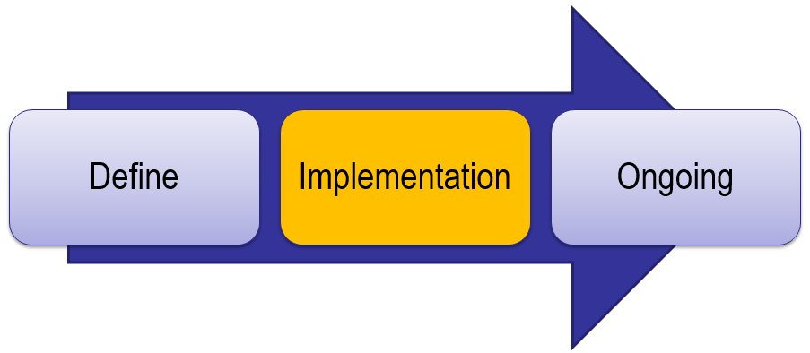
ETFS Timeline – Service Implementation
Service Implementation (Sept – Dec)
New Hire - DevOps resource
Startup cost – engage Microsoft Consulting for implementation and verification of service: $180k
IT Operations Team – support of service 24 x 7 x 365 – Train Team
Form SEMS DevOps Team: $200k
Begin migration of Division Teams
Objective and Deliverable | Hours -Low | Hours -High | Rate ($) | Cost -Low | Cost -High
TFS Infrastructure Planning and Validation
- TFS Usage Scenarios | 40 | 40 | 300 | $ 12,000 | $ 12,000
- TFS Infrastructure Plan | 24 | 24 | 300 | $ 7,200 | $ 7,200
- TFS Administration | 40 | 60 | 300 | $ 12,000 | $ 18,000
- TFS Installation Assistance including integrations ( Low estimate is for just the installation verification) | 20 | 80 | 300 | $ 6,000 | $ 24,000
- Architect/EM oversight | 24 | 40 | 340 | $ 8,160 | $ 13,600
Total | 148 | 244 |  | $ 45,360 | $ 74,800
TFS as a Service - Governance
- Shared Service Security Planning | 40 | 80 | 300 | $ 12,000 | $ 24,000
- Process Governance | 40 | 80 | 300 | $ 12,000 | $ 24,000
- Build Service Governance | 40 | 40 | 300 | $ 12,000 | $ 12,000
- Integration and Reporting Governance | 40 | 40 | 300 | $ 12,000 | $ 12,000
- Architect/EM oversight | 32 | 48 | 340 | $ 10,880 | $ 16,320
Total | 192 | 288 |  | $ 58,880 | $ 88,320
TFS as a Service - Team Onboarding
- Team on boarding process | 40 | 80 | 300 | $ 12,000 | $ 24,000
- Source Code Migration Strategy | 40 | 40 | 300 | $ 12,000 | $ 12,000
- Pilot Team on boarding assistance | 120 | 200 | 300 | $ 36,000 | $ 60,000
- Architect/EM oversight | 40 | 64 | 340 | $ 13,600 | $ 21,760
Total | 240 | 384 |  | $ 73,600 | $ 117,760
Grand total* | 580 | 916 |  | $ 177,840 | $ 280,880

Slide 20
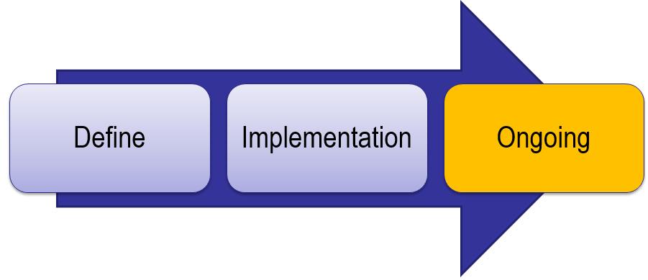
ETFS Timeline
Ongoing Service (Jan 2015 – Future)
Service available – open to all divisions/business groups/teams
$10/user per month
IT Operations Team cost
Assumes no additional resources needed
SEMS DevOps Team
New Team Onboarding - Migration and Training
Integrations with 3rd party tools
Extension to existing ETFS (e.g., Android Build/Test, iOS Build/Test)

Slide 21
ETFS Timeline – Ongoing Costs
# Ops Resources | Cost / Resource | # Service Manager Resources | Cost / Resource | Total Labor | Total Team Size | Monthly Infrastructure Cost | Total Cost | Number of Users | Annual Charge per User | Monthly Cost/User
1 | 90,000 | 0.25 | 200,000 | 140,000 | 1.25 | $1,500 | 141,500 | 100 | $1,415.00 | $117.92
1 | 90,000 | 0.25 | 200,000 | 140,000 | 1.25 | $1,500 | 141,500 | 200 | $707.50 | $58.96
1 | 90,000 | 0.25 | 200,000 | 140,000 | 1.25 | $1,500 | 141,500 | 300 | $471.67 | $39.31
1 | 90,000 | 0.25 | 200,000 | 140,000 | 1.25 | $1,500 | 141,500 | 400 | $353.75 | $29.48
1 | 90,000 | 0.25 | 200,000 | 140,000 | 1.25 | $1,500 | 141,500 | 500 | $283.00 | $23.58
1 | 90,000 | 0.25 | 200,000 | 140,000 | 1.25 | $1,500 | 141,500 | 600 | $235.83 | $19.65
1 | 90,000 | 0.25 | 200,000 | 140,000 | 1.25 | $1,500 | 141,500 | 700 | $202.14 | $16.85
1 | 90,000 | 0.25 | 200,000 | 140,000 | 1.25 | $1,500 | 141,500 | 800 | $176.88 | $14.74
1 | 90,000 | 0.25 | 200,000 | 140,000 | 1.25 | $1,500 | 141,500 | 900 | $157.22 | $13.10
1 | 90,000 | 0.25 | 200,000 | 140,000 | 1.25 | $1,500 | 141,500 | 1000 | $141.50 | $11.79
1 | 90,000 | 0.25 | 200,000 | 140,000 | 1.25 | $1,500 | 141,500 | 1100 | $128.64 | $10.72
1 | 90,000 | 0.25 | 200,000 | 140,000 | 1.25 | $1,500 | 141,500 | 1200 | $117.92 | $9.83
1 | 90,000 | 0.25 | 200,000 | 140,000 | 1.25 | $1,500 | 141,500 | 1300 | $108.85 | $9.07
1 | 90,000 | 0.25 | 200,000 | 140,000 | 1.25 | $1,500 | 141,500 | 1400 | $101.07 | $8.42
1 | 90,000 | 0.25 | 200,000 | 140,000 | 1.25 | $1,500 | 141,500 | 1500 | $94.33 | $7.86
1 | 90,000 | 0.25 | 200,000 | 140,000 | 1.25 | $1,500 | 141,500 | 1600 | $88.44 | $7.37
1 | 90,000 | 0.25 | 200,000 | 140,000 | 1.25 | $1,500 | 141,500 | 1700 | $83.24 | $6.94
1 | 90,000 | 0.25 | 200,000 | 140,000 | 1.25 | $1,500 | 141,500 | 1800 | $78.61 | $6.55
1 | 90,000 | 0.25 | 200,000 | 140,000 | 1.25 | $1,500 | 141,500 | 1900 | $74.47 | $6.21
1 | 90,000 | 0.25 | 200,000 | 140,000 | 1.25 | $1,500 | 141,500 | 2000 | $70.75 | $5.90

Slide 22
ETFS Timeline – Full Team Cost
Ops | Cost | DevOps | Cost | Service Manager |  | Total Labor | Team Size | Infrastructure | Investment | Total Cost | Number of Users | Annual Charge per User | Montly Cost/User
1 | 90,000 | 1.00 | 150,000 | 1 | 200,000 | 440,000 | 3.00 | $1,500 | $0.00 | 441,500 | 100 | $4,415.00 | $367.92
1 | 90,000 | 1.00 | 150,000 | 1 | 200,000 | 440,000 | 3.00 | $1,500 | $0.00 | 441,500 | 200 | $2,207.50 | $183.96
1 | 90,000 | 1.00 | 150,000 | 1 | 200,000 | 440,000 | 3.00 | $1,500 | $0.00 | 441,500 | 300 | $1,471.67 | $122.64
1 | 90,000 | 1.00 | 150,000 | 1 | 200,000 | 440,000 | 3.00 | $1,500 | $0.00 | 441,500 | 400 | $1,103.75 | $91.98
1 | 90,000 | 1.00 | 150,000 | 1 | 200,000 | 440,000 | 3.00 | $1,500 | $0.00 | 441,500 | 500 | $883.00 | $73.58
1 | 90,000 | 1.00 | 150,000 | 1 | 200,000 | 440,000 | 3.00 | $1,500 | $0.00 | 441,500 | 600 | $735.83 | $61.32
1 | 90,000 | 1.00 | 150,000 | 1 | 200,000 | 440,000 | 3.00 | $1,500 | $0.00 | 441,500 | 700 | $630.71 | $52.56
1 | 90,000 | 1.00 | 150,000 | 1 | 200,000 | 440,000 | 3.00 | $1,500 | $0.00 | 441,500 | 800 | $551.88 | $45.99
1 | 90,000 | 1.00 | 150,000 | 1 | 200,000 | 440,000 | 3.00 | $1,500 | $0.00 | 441,500 | 900 | $490.56 | $40.88
1 | 90,000 | 1.00 | 150,000 | 1 | 200,000 | 440,000 | 3.00 | $1,500 | $0.00 | 441,500 | 1000 | $441.50 | $36.79
1 | 90,000 | 2.00 | 150,000 | 1 | 200,000 | 590,000 | 4.00 | $1,500 | $0.00 | 591,500 | 1100 | $537.73 | $44.81
1 | 90,000 | 2.00 | 150,000 | 1 | 200,000 | 590,000 | 4.00 | $1,500 | $0.00 | 591,500 | 1200 | $492.92 | $41.08
1 | 90,000 | 2.00 | 150,000 | 1 | 200,000 | 590,000 | 4.00 | $1,500 | $0.00 | 591,500 | 1300 | $455.00 | $37.92
1 | 90,000 | 2.00 | 150,000 | 1 | 200,000 | 590,000 | 4.00 | $1,500 | $0.00 | 591,500 | 1400 | $422.50 | $35.21
1 | 90,000 | 3.00 | 150,000 | 1 | 200,000 | 740,000 | 5.00 | $1,500 | $0.00 | 741,500 | 1500 | $494.33 | $41.19
1 | 90,000 | 3.00 | 150,000 | 1 | 200,000 | 740,000 | 5.00 | $1,500 | $0.00 | 741,500 | 1600 | $463.44 | $38.62
1 | 90,000 | 3.00 | 150,000 | 1 | 200,000 | 740,000 | 5.00 | $1,500 | $0.00 | 741,500 | 1700 | $436.18 | $36.35
1 | 90,000 | 3.00 | 150,000 | 1 | 200,000 | 740,000 | 5.00 | $1,500 | $0.00 | 741,500 | 1800 | $411.94 | $34.33
1 | 90,000 | 3.00 | 150,000 | 1 | 200,000 | 740,000 | 5.00 | $1,500 | $0.00 | 741,500 | 1900 | $390.26 | $32.52
1 | 90,000 | 4.00 | 150,000 | 1 | 200,000 | 890,000 | 6.00 | $1,500 | $0.00 | 891,500 | 2000 | $445.75 | $37.15

Slide 23
Recommendations for ES Workgroup
Fund ETFS and eliminate user chargeback
Create “Software Developer Center of Excellence”
Coordinate training, demos, etc.. across groups/divisions
Provide “JumpStart” for software projects – process training, templates, app lifecycle recommendations
Communicate software teams successes and learnings – what works, what’s not
License purchasing coordination – purchase in volume
Rollup reporting across projects & divisions – insights into improvement

Slide 24
Technology Platform and Roadmap
Requirements
Authoring Requirements document with Enterprise defined structure, methodology, and process
Cloud Hybridization
Cross Platform Builds
(iOS / Xamarian / Android / Linux)
Rollup Reporting
(self-service reporting portal)
Value Added
DevOps
Automated build, deploy and testing harnesses
Enterprise Software Development Process
Process Template
Project Management
Requirements Management
Version Control
Test Case Management
Build Automation
Reporting
TFS Technology
Platform
TFS

Slide 25
Task Timeline
Service Available
Jan
Aug | Sep | Oct | Nov | Dec | Jan | Feb | Mar | Apr | May | Jun | July
Cost
Migration Tool Investigation
Install QA/PROD
IT Ops Team Training
Build Team Onboarding Queue
Onboard HIS Teams
Onboard SEMSTFS teams

Slide 26
Setup Investment
Objective and Deliverable | Hours -Low | Hours -High | Rate ($) | Cost -Low | Cost -High
TFS Infrastructure Planning and Validation
- TFS Usage Scenarios | 40 | 40 | 300 | $ 12,000 | $ 12,000
- TFS Infrastructure Plan | 24 | 24 | 300 | $ 7,200 | $ 7,200
- TFS Administration | 40 | 60 | 300 | $ 12,000 | $ 18,000
- TFS Installation Assistance including integrations ( Low estimate is for just the installation verification) | 20 | 80 | 300 | $ 6,000 | $ 24,000
- Architect/EM oversight | 24 | 40 | 340 | $ 8,160 | $ 13,600
Total | 148 | 244 |  | $ 45,360 | $ 74,800
TFS as a Service - Governance
- Shared Service Security Planning | 40 | 80 | 300 | $ 12,000 | $ 24,000
- Process Governance | 40 | 80 | 300 | $ 12,000 | $ 24,000
- Build Service Governance | 40 | 40 | 300 | $ 12,000 | $ 12,000
- Integration and Reporting Governance | 40 | 40 | 300 | $ 12,000 | $ 12,000
- Architect/EM oversight | 32 | 48 | 340 | $ 10,880 | $ 16,320
Total | 192 | 288 |  | $ 58,880 | $ 88,320
TFS as a Service - Team Onboarding
- Team on boarding process | 40 | 80 | 300 | $ 12,000 | $ 24,000
- Source Code Migration Strategy | 40 | 40 | 300 | $ 12,000 | $ 12,000
- Pilot Team on boarding assistance | 120 | 200 | 300 | $ 36,000 | $ 60,000
- Architect/EM oversight | 40 | 64 | 340 | $ 13,600 | $ 21,760
Total | 240 | 384 |  | $ 73,600 | $ 117,760
Grand total* | 580 | 916 |  | $ 177,840 | $ 280,880
Startup cost – bring in Microsoft Consulting for implementation and consultation of service setup and verification: $180k

Slide 27
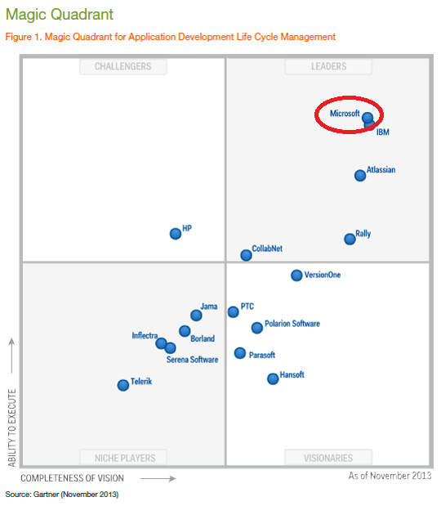






Why TFS?
Notes:
Magic Quadrant from TFS 2012
Large companies = US Bank, Target, Boeing, Dell, HP
TFS - market leader
In use widespread use within 3M
SEMS active user since 2006 – initial version of TFS
In use by other large companies for Enterprise wide use

Slide 28
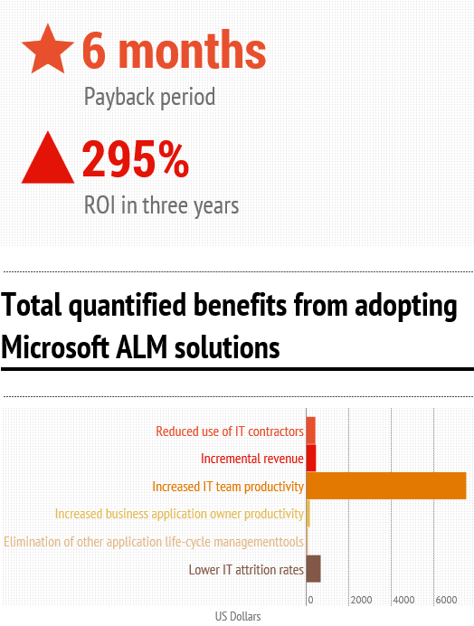
Benefits of Enterprise TFS Solution
Centralized Repository
High Availability
Improved Disaster Recovery
Increased collaboration/sharing
Reduced cost
Support Specialists – customization, maintenance and support
Visibility – customized Key Performance Indicators (KPI’s)
Training – increased knowledge of capabilities
Infography created by InCycle Software
Source information from Forrester: The Total, Economic Impact of Microsoft Application Life Cycle Mangement
Notes:
Dell case study – ROI: 225% Payback: 6 months
CollabNet case study: ROI 225% Payback: 12 months
Key benefits from case studies?

Slide 29
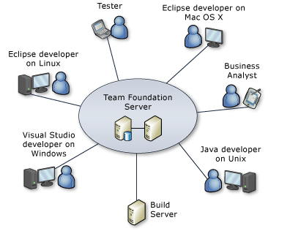
Who would use ETFS?
Project Management – plan, schedule, assign and track a project
Business Analyst – record and track requirements
Tester – track bugs – what’s fixed, what to test
Software development teams – Windows / Android / iOS / embedded systems
DevOps – automated build, test and deploy
Stakeholders – see progress of project
Regulatory – track requirements and outstanding issues
Product teams (e.g., XBox) have successfully used TFS for hardware/software delivery.
Globally available

Slide 30
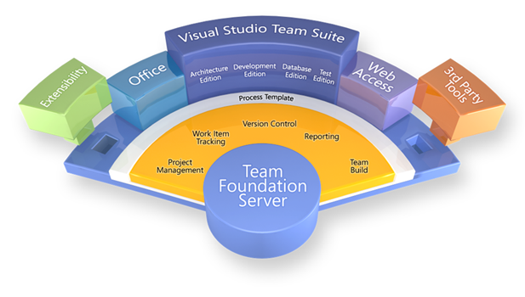
NTI-Core: Software Life-cycle Support System
Technology:
Establish a Software Life-cycle Support System (SLSS) by leveraging Microsoft Team Foundation Server (TFS).
Objectives:
Engage Microsoft Consulting
Deploy and Verify Service
Engage and Train IT Ops Team
Form SEMS DevOps Team
Initiate migration of HISD Team Projects
Migration of SEMSTFS Teams
Businesses – HISD, TSSD, IPD, DOC
Status: Pre-NTI to Explore (Sept – Dec)
Resources: $200 K
4.0 FTE for
Mike O’Brien 1.0 FTE
Don Carlson 0.5 FTE
New Hire for DevOps Team 1.0 FTE
DevOps Offshore resource 0.5 FTE
IT Operations Team 1.0 FTE
Dave Schaller – HISD
Scott Howard – HISD
Microsoft Consulting $180 k
Total funding request $380 K
Key SEMS Contact: Mike O’Brien

